Slide 1
Lecture 1: Introduction to Computer Security
RK Shyamasundar

Slide 2
Aims
Provide a thorough understanding of
Policy (what are being protected)
Mechanisms (authentication, authorization, auditing/monitoring, …)
Attacks (vulnerabilities, malware, …)
Assurance: How much can we assure and when?

Slide 3
Principles of Data and System Security: Syllabus
CS 745

Slide 4
References
Text Books
Security Engineering: A Guide to Building Dependable Distributed Systems, Ross Anderson, 2nd Edition, Wiley, 2008, SBN: 978-0-470-06852-6
Cryptography and Data Security – Dorothy Denning, Addison Wesley, 1988
Research Papers/ chapters

Slide 5
TAs
BS Radhika, radhikabs@cse.iitb.ac.in
Amit Goel, amitgoyal@cse.iitb.ac.in
Mayukh Rath mayuk@cse.iitb.ac.in

Slide 6
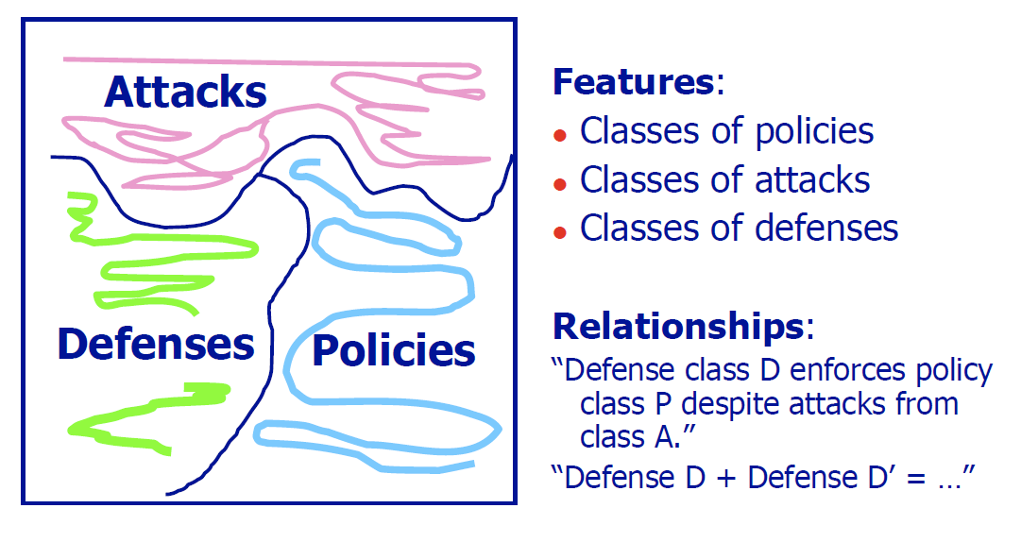
Security Is All About

Slide 7
Objectives
By the end of the course,
you should be able to design policies and mechanisms to protect a system from a given threat model

Slide 8
Principles of Data and System Security
Assessment
Two Exams: Midterm (30%) + Final (35%)
1 Group Project (15%) – Presentation/Demo
3 Assignments (20% ) – One of them in the Lab
Attendance Necessary
Note 1: You may collaborate when solving the assignments, however when writing up the solutions you should do so on your own.
Note 2: Group Projects: Everyone should contribute but must be aware of the whole solution
Note 3: Give credit to all assistance (with proper citations): literature, persons.
Note 4: Lab Experiments could be Via Cloud access

Slide 9
What is Security?
Computers are as secure as real-world systems, and people believe it.
Most real-world systems are not very secure by any absolute standard
Why tolerate such poor security in real-world systems?
Real world security is not about perfect defenses against determined attackers.
Instead, it’s about value, locks, and punishment.
The purpose of locks is to raise the threshold of casual break-in
Why Not Perfect Defense? TOO COSTLY

Slide 10
Whoever thinks his problem can be solved
using cryptography, doesn’t
understand his problem
and doesn’ t understand
cryptography.
ATTRIBUTED BY ROGER NEEDHAM AND BUTLER LAMPSON TO EACH OTHER

Slide 11
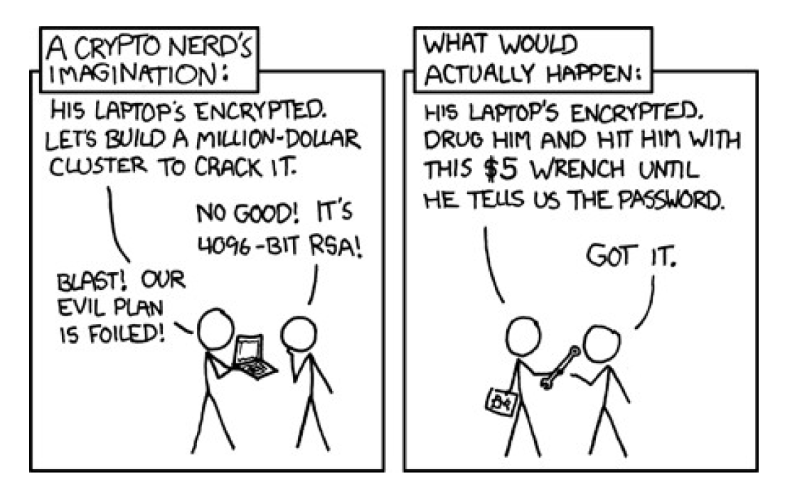

Slide 12
What is Computer Security
Cryptography is nearly perfect; Can computer security be as well?
NO
Software – Complicated Almost never perfect
Security set-up gets in the way
No quantifiable output

Slide 13
What is Computer Security
The science of managing malicious intent and behaviour that involves information and communication technology.
Malicious behaviour can include
Fraud/theft – unauthorised access to money, goods or services
Vandalism – causing damage for personal reasons (frustration, envy, revenge, curiosity, self esteem, peer recognition, . . . )
Terrorism – causing damage, disruption and fear to intimidate
Warfare – damaging military assets to overthrow a government
Espionage – stealing information to gain competitive advantage
Sabotage – causing damage to gain competitive advantage
“Spam” – unsolicited marketing wasting time/resources
Illegal content – child pornography, Nazi materials, . . .
Security vs safety engineering:
focus on intentional rather than accidental behaviour, presence of intelligent adversary.

Slide 14
Trustworthy Computer System
Exhibit all of the functionality users expect,
Not exhibit any unexpected functionality, and
Be accompanied by some compelling basis to believe that to be so,
Despite failures of system components, attacks, operator errors, and the inevitable design and implementation flaws found in software.

Slide 15
Dependability vs Security
Dependability = reliability + security
Reliability and security are often strongly correlated in practice
But malice is different from error!
Reliability: “ Co-author will be able to read this file”
Security: “The Pakistan Government won’t be able to read this file”
Beyond Byzantium
Proving a negative can be much harder …

Slide 16
Computer Security
Focuses on resisting attacks -- one of the factors of Trustworthiness
Practical Security
Tradeoff between Protection and the risk of loss
Fascinating intellectual discipline, practically a very important area with an enormous number of engineering challenges.

Slide 17
The computer security problem
Two factors:
Lots of buggy software (and gullible users)
Money can be made from finding and exploiting vulnerabilities.
Marketplace for vulnerabilities
Marketplace for owned machines (PPI)
Many methods to profit from owned client machines
current state of computer security

Slide 18
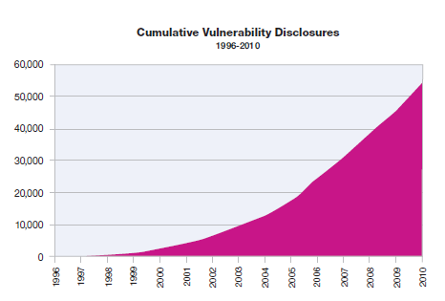
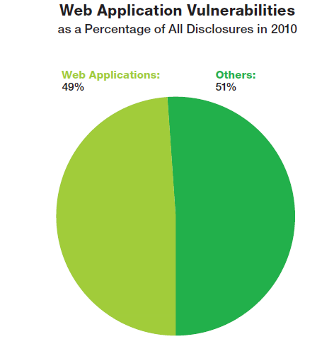
MITRE tracks vulnerability disclosures
Cumulative Disclosures
Percentage from Web applications
2010
Source: IBM X-Force, Mar 2011
Data: http://cve.mitre.org/

Slide 19
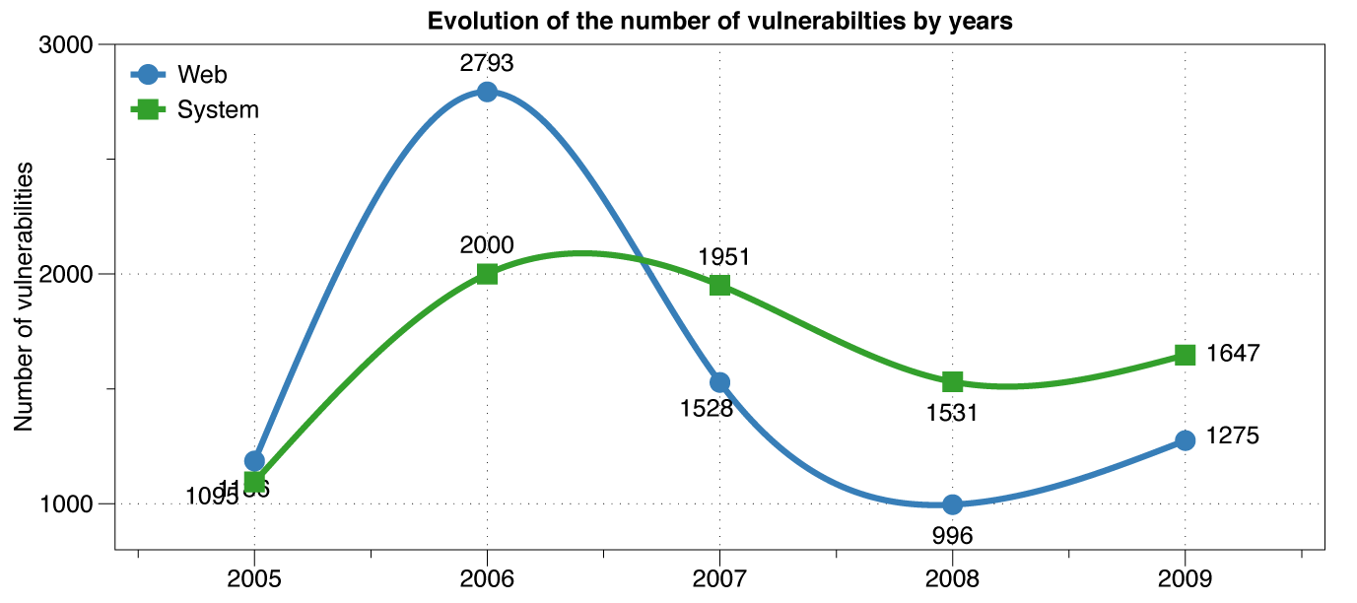
Web vs System vulnerabilities
XSS peak

Slide 20
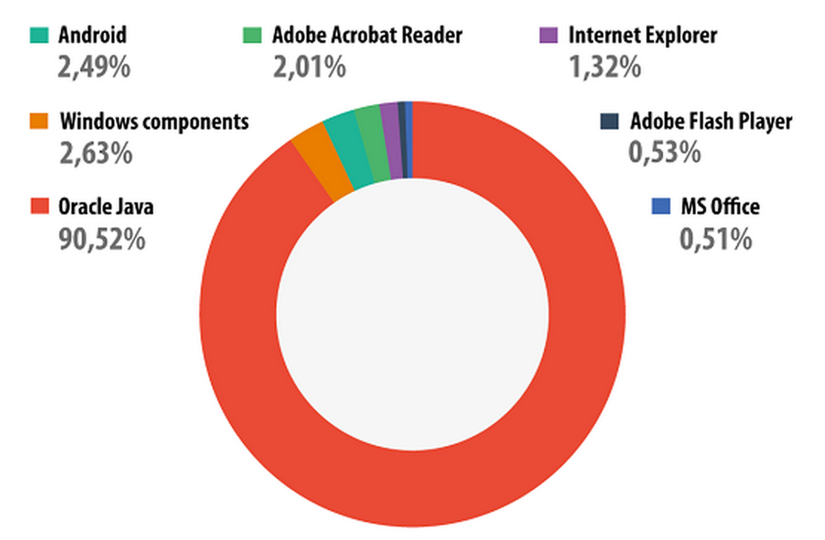
Vulnerable applications being exploited
Source: Kaspersky Security Bulletin 2013

Slide 21
Marketplace for Vulnerabilities
Option 1: bug bounty programs (many)
Google Vulnerability Reward Program: up to 20K $
Microsoft Bounty Program: up to 100K $
Mozilla Bug Bounty program: 500$ - 3000$
Pwn2Own competition: 15K $
Option 2:
ZDI, iDefense: 2K – 25K $
Notes:
There are many people who work on finding vulnerabilities in software, such as Windows or software that runs on top of windows. Finding an explotable vulnerability can take months and the question is what to do when they find one. Most likely they publish an article in a security conference like Blackhat and boost their reputation. But it shouldn’t be too surprising that they can also make money from selling the vulnerability before announcing it at a conference. There are three options.

Slide 22
Marketplace for Vulnerabilities
Option 1: bug bounty programs (many)
Google Vulnerability Reward Program: up to 20K $
Microsoft Bounty Program: up to 100K $
Mozilla Bug Bounty program: 500$ - 3000$
Pwn2Own competition: 15K $
Option 2:
ZDI, iDefense: 2K – 25K $
Notes:
There are many people who work on finding vulnerabilities in software, such as Windows or software that runs on top of windows. Finding an explotable vulnerability can take months and the question is what to do when they find one. Most likely they publish an article in a security conference like Blackhat and boost their reputation. But it shouldn’t be too surprising that they can also make money from selling the vulnerability before announcing it at a conference. There are three options.

Slide 23
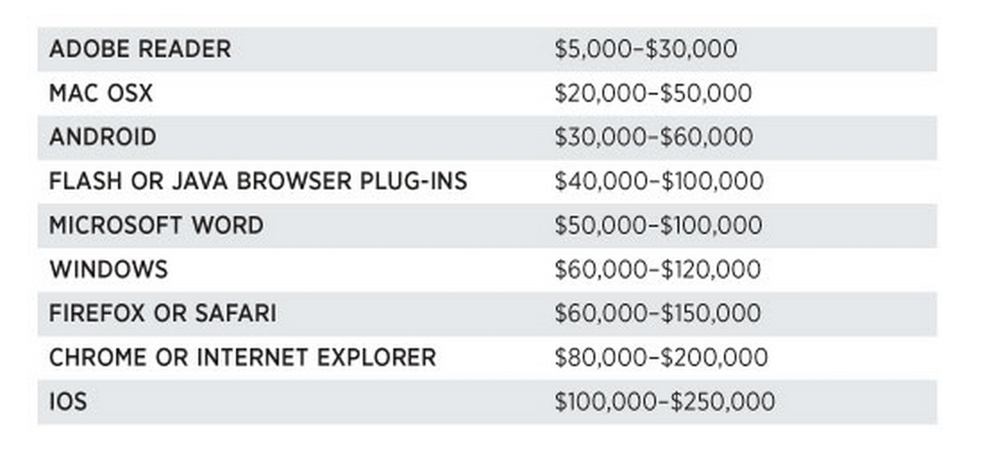
Marketplace for Vulnerabilities
Option 3: black market
Source: Andy Greenberg (Forbes, 3/23/2012 )
Notes:
Now, the 3rd option is to go to the black market. We don’t quite know the value of vulns. there, but I list here a few quotes that suggest that prices could be higher than with the other two options.

Slide 24
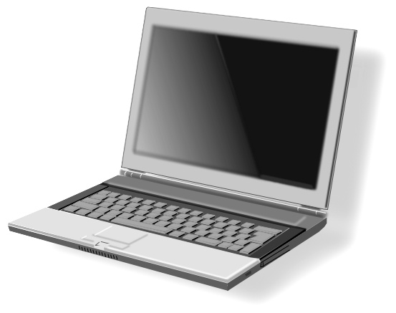
Marketplace for owned machines
Pay-per-install (PPI) services
PPI operation:
Own victim’s machine
Download and install client’s code
Charge client
clients
spam bot
keylogger
PPI service
Victims
Source: Cabalerro et al. (www.icir.org/vern/papers/ppi-usesec11.pdf)

Slide 25
Marketplace for owned machines
clients
spam bot
keylogger
Cost: US - 100-180$ / 1000 machines
Asia - 7-8$ / 1000 machines
PPI service
Victims
Source: Cabalerro et al. (www.icir.org/vern/papers/ppi-usesec11.pdf)

Slide 26
Process of Science

Slide 27
Secure or Insecure
Insecure!
Secure?
Suppose we have a precisely defined security claim about a system,
from which we can derive the consequences which can be tested,
Then in principle we can prove that the system is insecure.
Suppose you design a system, derive some security claims, and discover every time that the system remains secure under all tests.
Is the system then secure?
No, it is simply not proved insecure.
In the future you could refine the security model, there could be a wider range of tests and attacks, and you might then discover that the thing is insecure.

Slide 28
Importance of Computer Security
Wide ubiquitous usage of computers and Internet, need to ensure continuous dependable operations:
Business environment: legal compliance, cash flow, profitability, commercial image and shareholder confidence, product integrity, intellectual property and competitive advantage
Military environment: exclusive access to and effectiveness of weapons, electronic countermeasures, communications secrecy, identification and location information, automated defenses
Medical environment: confidentiality and integrity of patient records, unhindered emergency access, equipment safety, correct diagnosis and treatment information
Households: privacy, correct billing, burglar alarms
Society at large: Utility/Infrastructure services, communications, transport, tax/benefits collection, goods supply, . . .

Slide 29
Studying Security of a System
Speciﬁcation/Policy: What is the system sup-posed to do?
Implementation/Mechanism: How does it realize it?
Correctness/Assurance: Does it really work?

Slide 30
POLICY: SPECIFYING SECURITY
Specify the needs of stakeholders
Confidentiality/Secrecy: Controlling who gets to read information.
Integrity: controlling how information changes
Availability: providing prompt access to information and resources
Accountability: knowing who has had access to information or resources.

Slide 31
Aspects of Integrity and Availability Protection
Rollback – ability to return to a well-defined valid earlier state backup, revision control, undo function)
Authenticity – verification of the claimed identity of a communication partner
Non-repudiation – origin and/or reception of message cannot be denied in front of third party
Audit – monitoring and recording of user-initiated events to detect and deter security violations
Intrusion detection – automatically notifying unusual events
Optimistic security: Temporary violations of security policy are tolerated where correcting the situation is easy and the violator is accountable. (Applicable to integrity and availability, but usually not to confidentiality requirements.)
Notes:
Kuhn

Slide 32
Dangers Being Protected Against
Damage to information
Disruption of service
Theft of physical resources like money
Theft of information
Loss of privacy
Integrity
Availability
Integrity
Secrecy (confidentiality)
Secrecy (confidentiality)

Slide 33
Taxonomy of Cybersecurity Threats
Incomplete, inquisitive, and unintentional blunders.
Hackers driven by technical challenges.
Disgruntled employees or customers seeking revenge.
Criminals interested in personal financial gain, stealing services, or industrial espionage.
Organized crime with the intent of hiding something or financial gain.
Organized terrorist groups attempting to influence U.S. policy by isolated attacks.
Foreign espionage agents seeking to exploit information for economic, political, or military purposes.
Tactical countermeasures intended to disrupt specic weapons or command structures.
Multifaceted tactical information warfare applied in a broad orchestrated manner to disrupt a major military mission.
Large oganized groups or nation-states intent on overthrowing a government.

Slide 34
Variants of confidentiality
Data protection/personal data privacy – fair collection and use of personal data, in Europe a set of legal requirements
Anonymity/untraceability – ability to use a resource without disclosing identity/location
Unlinkability – ability to use a resource multiple times without others being able to link these uses together
HTTP “cookies” and the Global Unique Document Identifier (GUID) in Microsoft Word documents were both introduced to provide linkability.
Pseudonymity – anonymity with accountability for actions.
Unobservability – ability to use a resource without revealing this activity to third parties
low probability of intercept radio, steganography, information hiding
Copy protection
Information flow control- ability to control the use and flow of information
Further details: Pfitzmann/Kohntopp: http://www.springerlink.com/link.asp?id=xkedq9pftwh8j752

Slide 35
MECHANISM: IMPLEMENTING SECURITY
Security Implementation:
Code: The actual program on which the security depends
Setup: data that controls the programs’ operations: folder structure, access control lists, group memberships, user passwords or encryption keys, and so on.
Implementation must defend against:
Bad, buggy and hostile vulnerabilities

Slide 36
Broad Defensive Startegies
Isolate—keep everybody out
coarse-grained strategy provides the best security, but it keeps users from sharing info. or services.
impractical for all but a few applications.
Exclude—keep the bad guys out
Medium grained strategy makes it all right for programs inside this defense to be gullible. Code signing and ﬁrewalls do this.
Restrict—let the bad guys in, but keep them from doing damage.
Fine-grained strategy, also known as sandboxing, can be implemented traditionally with an OS process or with a more modern approach that uses a Java virtual machine.
Sandboxing typically involves access control on resources to define the holes in the sandbox. Programs accessible from the sandbox must be paranoid, and it’s hard to get this right.
Recover—undo the damage.
Exemplified by backup systems and restore points, doesn’t help with secrecy, but it does help with integrity and availability.
Punish—catch the bad guys and prosecute them.
Auditing and police do this.
Notes:
Lampson

